Slide 1
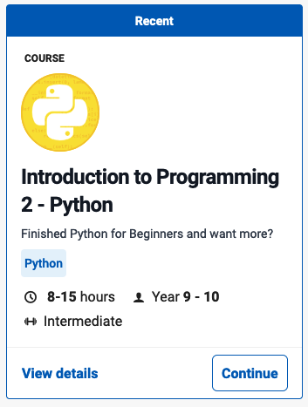
File Operations
Introduction to Programming 2 - Python
Grok Learning

Slide 2
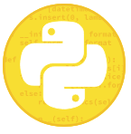
File Operations
Files
Files
Reading from files
Directories and Paths
Opening and looping
Opening files
Looping over files
* Shout your orders!
Writing files
Writing files
Writing to files using print
Closing files after opening them
* The dog wrote it!
End File Operations

Slide 3
Files
So far, all our questions have dealt with information read in from the user, but this restricts what we can do quite a lot. To learn about data manipulation, writing more powerful programs, and solving more interesting problems, we will also need to use data from other sources, such as files.
This module will introduce how to open, read and write files.

Slide 4
Reading from files
Python makes reading input from a file (as opposed to input directly from the user) very simple. In fact, reading multiple lines from files is even easier than reading them from the user using input.
Before a program can read data from a file, it must tell the operating system that it wants to access that file. Files sitting in the same directory as the running program can be referred to just using the filename, e.g. test.txt. This is the setup we will use here.

Slide 5
Directories and Paths
A directory is the technical name for a folder. Accessing files in other directories requires extra directions to the file called a path. There are two kinds of paths: absolute paths and relative paths.
An absolute path starts from a fixed (or absolute) location on disk called the root (which on Windows is the drive name, like C:). This means absolute paths can be accessed in the same way from any directory. On Windows, absolute paths therefore start with a drive letter. On Mac OS X/Linux it means an absolute path starts with a forwards slash e.g. /usr/bin/python3.3.
A relative path starts from (that is, is relative to) the current directory and goes from there. The relative path .. refers to the parent directory, so ../../data.txt goes up two levels (to the grandparent directory) to find data.txt. Whereas data/colours/rainbow.txt goes down two levels from the current directory, inside data and then colours to find rainbow.txt.
An absolute path is like a set of directions that start from somewhere recognisable (e.g. the Opera House), while a relative path is like a set of directions that start from where the person is standing now.
Hint
This means that any text files that you download or you have typed in yourself will need to be copied into the same directory as the Python programs you are writing.

Slide 6
Opening files
The process of requesting access to a file is called opening a file (just like it is for users) and is done using the builtin function open. This creates a Python object which we can then read from. For instance, imagine we had the following in a file called test.txt:
test.txt
eins
zwei
drei
We can open this file in Python using the following:
f = open('test.txt’)
print(f)
When run, this outputs the following:
<_io.TextIOWrapper name='test.txt' mode='r' encoding='UTF-8'>​
This angle bracket representation is used for types in Python that it doesn't make sense to print (like the whole contents of the file). But it lets you know that you successfully opened the file.)
What happens when you try to open a file that doesn't exist or isn't in the location you expect it to be:
f = open('missing.txt')
Traceback (most recent call last):
file "program.py", line 1, in <module>
f = open('missing.txt’)
FileNotFoundError: [Errno 2] No such file or directory: 'missing.txt'​
You get a FileNotFoundError exception. More importantly you also get the message No such file or directory which tells you what particular problem has occurred.

Slide 7
Looping over files
Okay, now after all that it's easy to read from an opened file! Here's our test.txt file:
test.txt
eins
zwei
drei
You can treat it just like a list in a for loop:
f = open(‘test.txt’)
for line in f:
print(line.strip())
eins
zwei
drei​
That's all there is to reading in a file! As you can see it is actually shorter than using input in a while loop. Notice that we have put a strip on the print line. That's because line still has the newline character on the end. Try removing it to see what happens to the output.
Now we can actually make this a bit shorter because we don't need to put the file in a separate variable (f), so we can substitute it straight into the for loop itself:
for line in open('words.txt’):
print(line.strip())
This produces the same output as the example above and is the recommended approach to read input from files.
We could also use some nifty syntax to logically separate out the opening of the file and the reading of the file:
with open('words.txt') as f:
for line in f:
print(line.strip())

Slide 8
** Shout your orders!
The kitchen in any café is a noisy place. To make sure the orders which you have carefully written down on your notepad make it to the chef, you'll need to shout them! Write a program to read in lines of input from the file called orders.txt, and print out each line in uppercase.
For example, if orders.txt contains:
Tomato and cheese melt
Pumpkin soup
Chicken and avocado sandwich​
then your program should output:
TOMATO AND CHEESE MELT
PUMPKIN SOUP
CHICKEN AND AVOCADO SANDWICH​
Create the example orders.txt file
Output the file.

Slide 9
** Shout your orders! Solution

Slide 10
Writing files
You can write to files using very similar syntax to reading them.
First, we need to open a file object, adding an additional argument to signify that this file will be written to (instead of read from).
f = open('output.txt', 'w’)
f.write("Hello, world!")
f.write("Now we're working with files!")
f.close()
Note that we use the letter 'w' as the second argument to open when opening the file (output.txt). The 'w' stands for write mode. When this second argument is not provided, it defaults to 'r' for read mode.
After running the above block of code, if we look at the contents of output.txt, we see:
Hello, world!Now we're working with files!
Note that the two lines of output were actually written on one line! This is because the .write() method on a file object does not add any newline characters. To fix this, we'll need to write a newline character '\n' to the file at the end of each line.
f = open('output.txt', 'w’)
f.write("Hello, world!\n")
f.write("Now we're working with files!\n")
f.close()
Now when we look at output.txt, we see:
Hello, world!
Now we're working with files!​

Slide 11
Writing to files using print
Having to remember to manually add these newline characters each time you want to write a line of output is annoying. However, there is another way to write lines of text to an output file. Our familiar print function can be used to send its contents to a file object instead of to your screen.
Modifying the last example on the previous slide to use the print function, we get the following:
f = open('output.txt', 'w’)
print("Hello, world!", file=f)
print("Now we're working with files!", file=f)
f.close()
This file keyword argument allows you to specify where the print function sends its output to. This file keyword argument works in conjunction with the other keyword arguments we've seen print take, such as sep:
sounds = {'dog': 'a barker', 'cat': 'a meower', 'bird': 'a tweeter’}
f = open('output.txt', 'w’)
for animal in sorted(sounds):
sound = sounds[animal]
print('A', animal, 'is', sound, sep='--', file=f)f.close()
After this code has been run, the contents of output.txt will be:
A--bird--is--a tweeter
A--cat--is--a meower
A--dog--is--a barker

Slide 12
Closing files after opening them
You will have noticed on the previous slides that, after we have finished writing to the file objects, we call the .close() method on the file. If you forget to call the .close() method on a file you have been writing to, you are not guaranteed that what you have written to the file will actually be written to disk! This is because the operating system does some clever optimisation things and doesn't always write things to disk at the time that you tell it to. It sometimes chooses to delay writing them to disk until a more opportune time exists. As such, it is crucial that you remember to close your files after writing to them.
Remembering to close your files is annoying, so there's a more convenient way to tell Python to do it for you when you're finished with writing! When we first looked at opening files, we saw the with statement, which we can use to separate out the logic for opening files from the logic of processing files. If you use a with block to open a file for writing, the .close() method is automatically called by Python when the code exits the body of the with block. Rewriting the previous example to use a with block, we get the following:
sounds = {'dog': 'a barker', 'cat': 'a meower', 'bird': 'a tweeter’}​
with open('output.txt', 'w') as f:
for animal in sorted(sounds):
sound = sounds[animal]
print('A', animal, 'is', sound, sep='--', file=f)
Note that we do not need the f.close() line at the end of the program.

Slide 13
** The dog wrote it!
You were working hard writing a letter to your penpal, only to realise that your dog has been "helping" and contributing to the letter too! You notice that every few lines starts with WOOF! and includes things you simply didn't write!
Write a program to read in lines from the file letter.txt and write out a new file, fixed.txt, which contains the only lines that do not start with WOOF!.
For instance, given the following letter.txt:
My vegetable garden is growing really well!
WOOF! Let's play catch!
The tomatoes and cucumbers are nearly ready to eat.
How is your garden going?
WOOF! I better chase that possum!
your program should create the file fixed.txt that contains:
My vegetable garden is growing really well!
The tomatoes and cucumbers are nearly ready to eat.
How is your garden going?

Slide 14
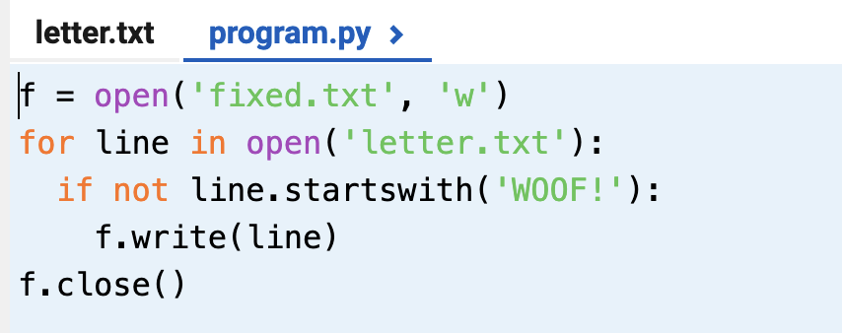
** The dog wrote it! Solution
Sample Solution #1
Sample Solution #2

Slide 15
End File Operations

