Slide 1
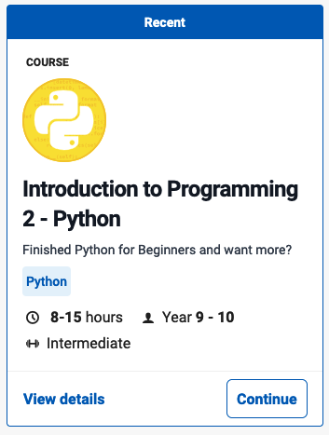
Python Review
Introduction to Programming 2 - Python
Grok Learning

Slide 2
Python Review
Review of introduction to programming
Printing in Python
Python the calculator
Getting input from the user
Two kinds of numbers
Division
** Maths mix
Letters and words
Manipulating strings
Making decisions
Conditional expressions
Storing multiple values
Creating and modifying lists
Manipulating lists
** Robots in a line
Repeating things (for)
The range function
** Up the lift
Repeating things (while)
** Guessing game
End review

Slide 3
Overview and Introduction Review of Introduction to Programming
This course builds on the Python for Beginners course. This first module is a refresher of the concepts covered in that course.
As tradition dictates, let's start with a Hello World program:
print('Hello, World!')
You can edit and run any example in Grok by clicking run. Try changing 'Hello, World!' to 'Hi!', and running it again.
Once you've changed an example, you can select the back arrow (next to the run button ). Click it and the code swaps back to the original. Click again, it swaps back to your version.
For more information on coding basics:
https://www.bbc.co.uk/bitesize/guides/zwmbgk7/revision/1
https://www.w3schools.com/python/python_intro.asp

Slide 4
Printing in Python
The Python print function can take multiple arguments, and the joining (sep) and ending (end) strings can be specified. For example:

Slide 5
Python the calculator
Python is a powerful calculator. You can use it to do all the standard mathematical operations, and order of operations is obeyed. For example:
Division returns a float, even if both numbers are integers.
The modulus (or mod) operator % returns the remainder after division:
And you can use the ** operator to raise a number to a power (exponentiation):

Slide 6
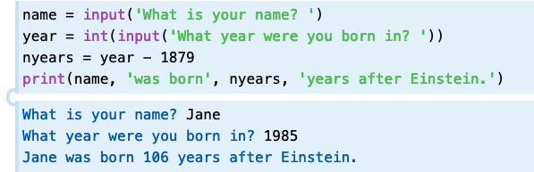
Getting input from the user
In Python 3, the input function reads in a string provided by the user. If you want to convert the input to a different type, such as a float or integer, you need to cast to the appropriate type. For example:
The year variable needs to be converted to an integer(int) so that we can perform the subtraction.
When you run examples on the website that require user input, the program will print out the prompt and wait for input from you. Simply type into the text box and hit enter.

Slide 7
Data Types Two kinds of numbers
There are two types of numbers in Python. Whole numbers (or integers) have the type int, and fractional or decimal numbers have the type float.
You can convert between types by casting using the int and float functions:
Notice that when you cast from a float to an int the result is truncated (not rounded like you are used to in maths).
A quiz on Basics: https://www.bbc.co.uk/bitesize/guides/zwmbgk7/test

Slide 8
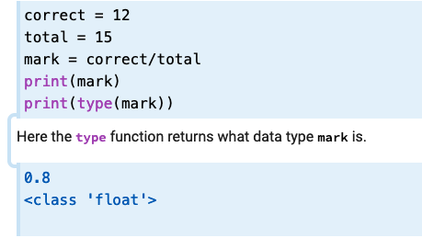
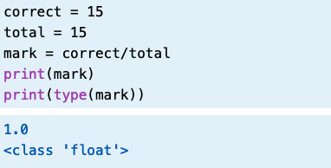
Division
In Python 3, division always returns a float (even when both the original numbers are integers). For example:
A float is returned even when the result is a whole number:

Slide 9
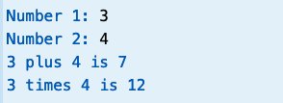
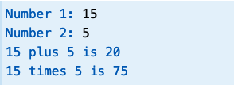
** Maths mix
Write a program that reads in two integers, then prints out the sum of them (added together) and the product (multiplied together).
Your program should work like this:
For example:
Here is another example:

Slide 10
** Maths mix Solution

Slide 11
Letters and words

Slide 12
Manipulating strings

Slide 13
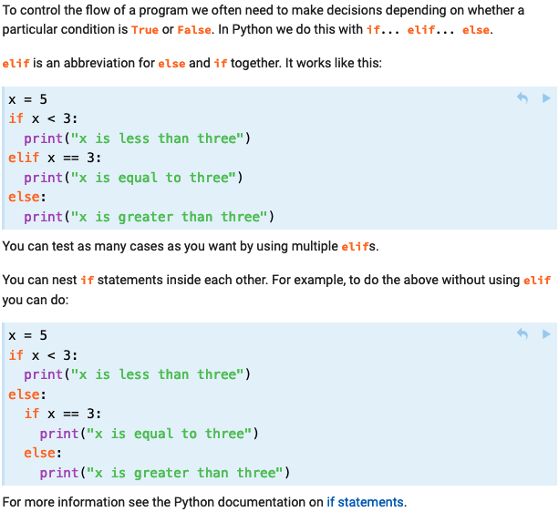
Making decisions
For more information on Selection:
https://www.bbc.co.uk/bitesize/guides/z2p9kqt/revision/1
https://www.w3schools.com/python/python_conditions.asp

Slide 14
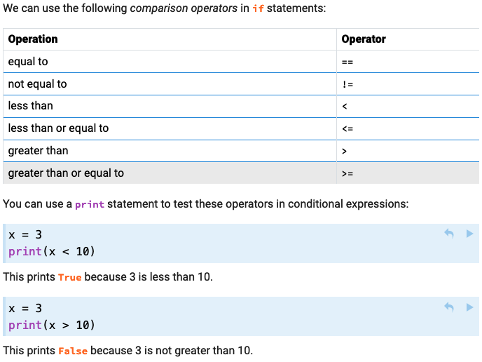
Conditional expressions
A quiz on Selection: https://www.bbc.co.uk/bitesize/guides/zy9thyc/test

Slide 15
Storing multiple values
For more information on Arrays and Lists:
https://www.bbc.co.uk/bitesize/guides/zy9thyc/revision/1
https://www.w3schools.com/python/python_lists.asp

Slide 16
Creating and modifying lists

Slide 17
Manipulating lists
A quiz on Arrays and Lists: https://www.bbc.co.uk/bitesize/guides/zy9thyc/test

Slide 18
** Robots in a line!

Slide 19
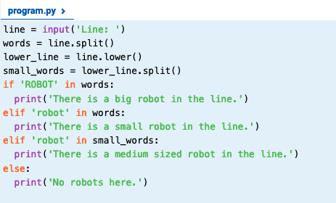
** Robots in a line! Solution

Slide 20
Control Structures Repeating things (for)
For more information on Repeating (for, while loops):
https://www.bbc.co.uk/bitesize/guides/z3khpv4/revision/1
https://www.w3schools.com/python/python_for_loops.asp

Slide 21
The range function

Slide 22
** Up the lift

Slide 23
** Up the lift Solution

Slide 24
Repeating things (while)
For more information on Repeating (while loops):
https://www.bbc.co.uk/bitesize/guides/z3khpv4/revision/1
https://www.w3schools.com/python/python_while_loops.asp
A quiz on Iteration: https://www.bbc.co.uk/bitesize/guides/zy9thyc/test

Slide 25
** Guessing game

Slide 26
** Guessing game Solution

Slide 27
End Python Review

