Slide 1
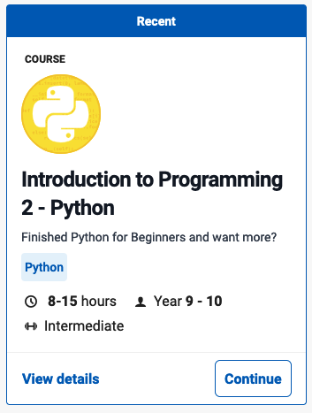
User Functions
Introduction to Programming 2 - Python
Grok Learning

Slide 2
User Functions
Functions
Python Functions
Modular coding
Example – Area of a rectangle
** Your turn
Functions Quiz
End user functions

Slide 3
Functions
A function is a block of code which only runs when it is called.
You can pass data, known as parameters, into a function.
A function can return data as a result.
See: https://www.w3schools.com/python/python_functions.asp
A definition from Grok Learning:

Slide 4
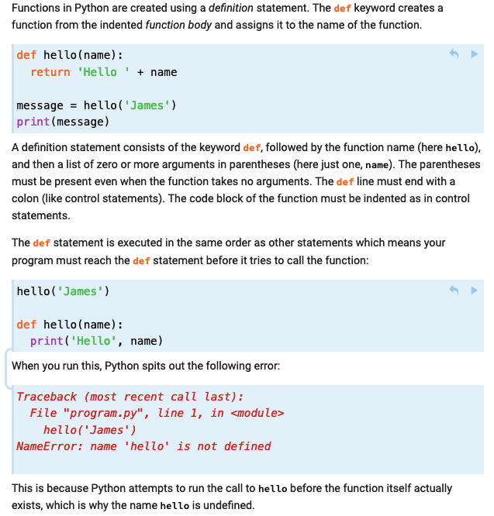
Python Functions
Creating a Function
In Python a function is defined using the def keyword:
Calling a Function
To call a function, use the function name followed by parenthesis:
Parameters or Arguments?
The terms parameter and argument can be used for the same thing: information that are passed into a function.
From a function's perspective:
A parameter is the variable listed in the function definition inside the parentheses.
An argument is the value that is sent to the function when it is called.

Slide 5
Modular coding
Modular coding is a useful method to structure a coding solution
Decomposing a problem usually gives a number of sections
Sections can be assigned to functions and ‘called’ when needed
Functions can be saved and recalled for use in other solutions
‘Top-down design’ uses functions defined and the main code calls them
Empty, named functions are created and blank code is installed – in Python, this is signified by the pass keyword
‘Bottom-up design’ creates a main code, and functions are created as required
Code can also be saved as separate files (often called ‘modules’), which can be ‘imported’ and called within the body of the code

Slide 6
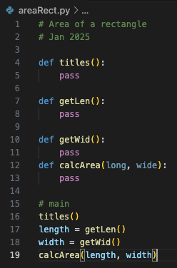
Example – Area of a rectangle
A program is required to calculate the area of a rectangle.
(areaRect = length * width)
Example of top-down design
Decomposition
Input | Process | Output
length, width | areaRect = length * width | area
Modular
Structure Chart
areaRect
main
width
length, width
length
titles
getLen
getWid
calcArea

Slide 7
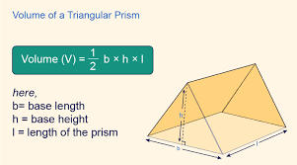
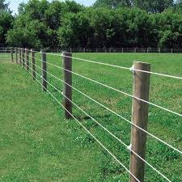
** Your turn
Create modular code using functions for the following basic problems:
A program to determine the volume of a triangular prism.
A program to calculate the length of wire needed to make a multistrand wire fence around a rectangular paddock
Create a basic pizza order program, where the size, base-type, sauce choice and toppings are entered.

Slide 8
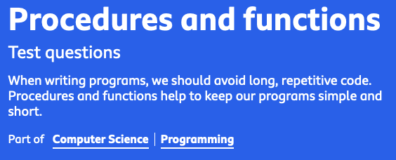
Functions Quiz
Go to: https://www.bbc.co.uk/bitesize/guides/zqh49j6/revision/1
Review Functions
Complete the quiz: https://www.bbc.co.uk/bitesize/guides/zqh49j6/test

Slide 9
End User Functions

