Slide 1
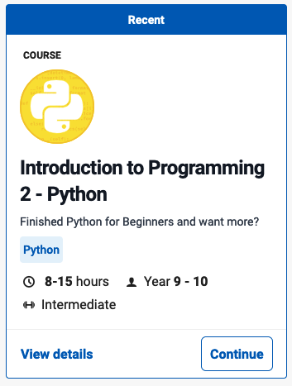
Dictionaries
Introduction to Programming 2 - Python
Grok Learning

Slide 2
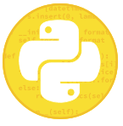
Dictionaries
Dictionaries
Python dictionaries
Accessing items in a dictionary
Checking if a key is in a dictionary
Printing out the contents of a dictionary
Adding and modifying dictionary items
** Word2SMS
Creating a dictionary
Creating a dictionary from input
Dictionary from input
** Favourite colour
Dictionary methods
Dictionary methods
Default values in dictionaries
Updating dictionaries
** Car colours
** Word counter
End dictionaries

Slide 3
Dictionaries Python dictionaries

Slide 4
Accessing items in a dictionary

Slide 5
Checking if a key is in a dictionary

Slide 6
Printing out the contents of a dictionary

Slide 7
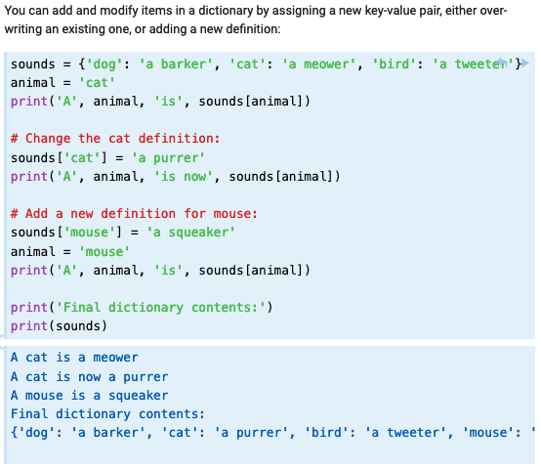
Adding and modifying dictionary items

Slide 8
** Word2SMS

Slide 9
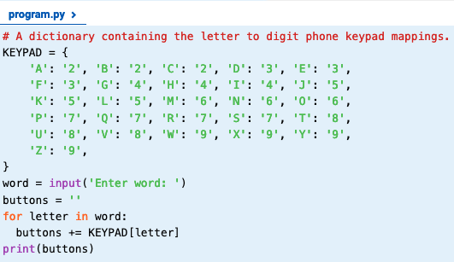
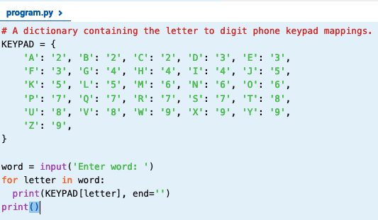
** Word 2SMS Solution
2 Solutions, each is correct

Slide 10
Creating a dictionary Creating a dictionary from input

Slide 11
Dictionary from input

Slide 12
** Favourite colour

Slide 13
** Favourite colour Solution

Slide 14
Dictionary methods Dictionary methods

Slide 15
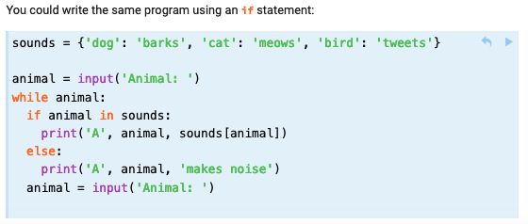
Default values in dictionaries

Slide 16
Updating dictionaries

Slide 17
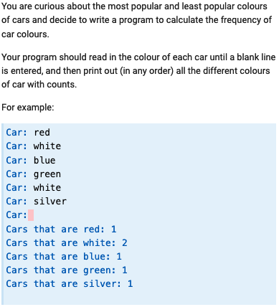
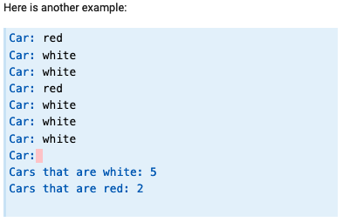
** Car colours

Slide 18
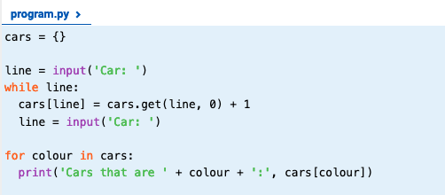
** Car colours Solution

Slide 19
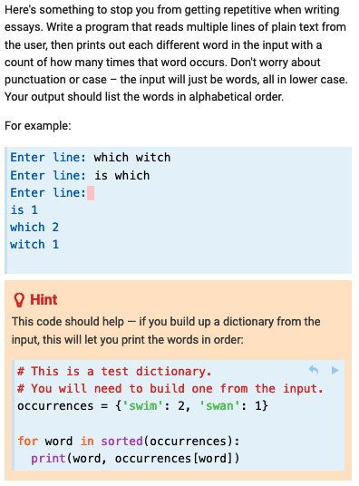
** Word counter

Slide 20
** Word counter Solution

Slide 21
End Dictionaries

